Slide 1
Input in Java
Week 3

Slide 2
Agenda
Recap of Last Lecture
Input through command line arguments
Input through scanner class
Input through JOptionPane class

Slide 3
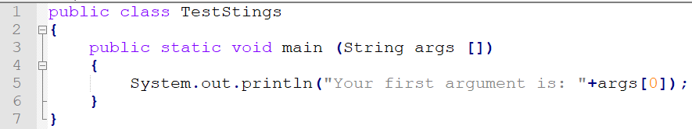
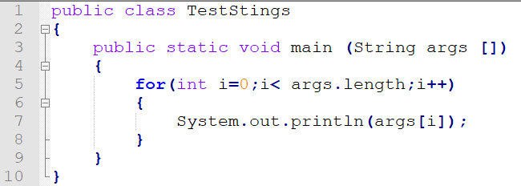
Java Command Line Arguments
The java command-line argument is an argument i.e. passed at the time of running the java program. The arguments passed from the console can be received in the java program and it can be used as an input.
All command line input datatype is string

Slide 4
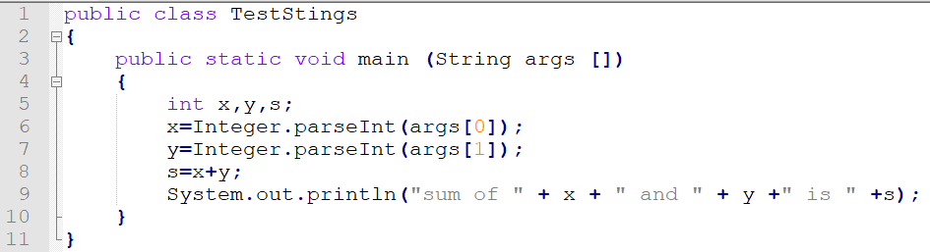
Java Command Line Arguments- Adding two numbers

Slide 5
Input through Scanner Class
Scanner is a class in java.util package used for obtaining the input of the primitive types like int, double, etc. and strings.
It is the easiest way to read input in a Java program, though not very efficient if you want an input method for scenarios where time is a constraint like in competitive programming.
  To create an object of Scanner class, we usually pass the predefined object System.in, which represents the standard input stream.
  To read numerical values of a certain data type XYZ, the function to use is nextXYZ(). For example, to read a value of type short, we can use nextShort()
  To read strings, we use nextLine().
  To read a single character, we use next().charAt(0). next() function returns the next token/word in the input as a string and charAt(0) function returns the first character in that string.

Slide 6
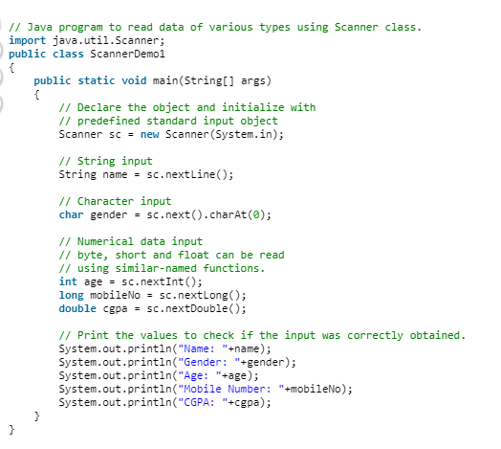

Slide 7
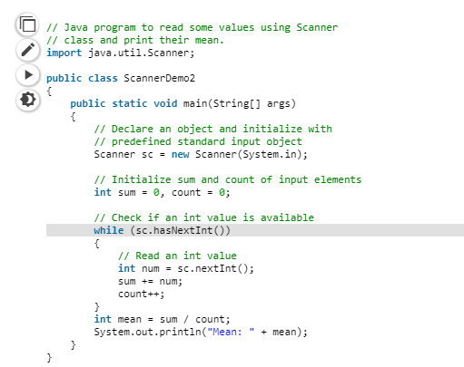

Slide 8
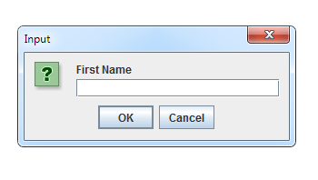
Input through JOptionPane
Another useful class for accepting user input, and displaying results, is the JOptionPane class.
This is located in the javax.swing library.
The JOptionPane class allows you to have input boxes like this one:

Slide 9
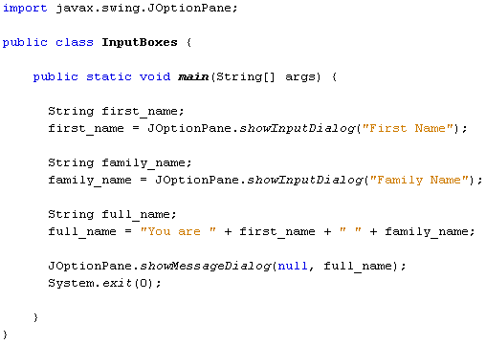

Slide 10
